Slide 1

Scanning helps to understand the context of your preferred future – where you want to go.

Slide 2
ENVIRONMENTAL SCAN
“Managing” – Look both inside and outside.
100: We Look INSIDE and OUTSIDE the org.
General Environment:
Political
Economic
Social
Technological
Demography
Business Environment:
Customers
Suppliers
Competitors
Many other stakeholders!
Inside the Org:
Structure / Functions
Fin/Acct HRM
Operations Marketing

Slide 3
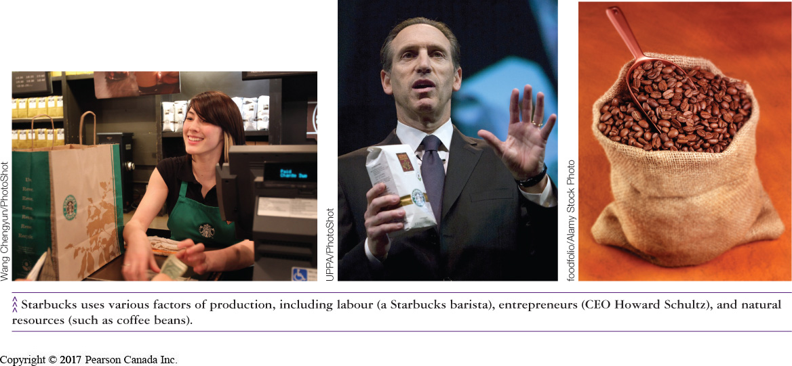
The Idea of Business and Profit (LO 1-1)
Businesses produce or sell products in order to make a profit
Profit
Revenues
Expenses
Non-profit Organizations
provide goods and services but do not seek profit
schools, hospitals
Notes:
Learning Objective: 1-1
Page: 6
Notes
The text focuses on businesses only, since they generate profits. However, this discussion can be expanded to include other organizations that are active in our society which are not profit-based:
- charitable organizations
- government enterprises
The difference is that the profit motive is not present, so volunteerism is an important part of the organization’s composition.
Activity
Have students research a corporation in the library using the corporate reports. Have the students work in groups to identify the products/services sold, and the profitability of the firm in return for risking its assets to produce the goods.

Slide 4
Economic Systems Around the World (LO 1-2)
Market Economies
Command Economies
Capitalism
Mixed Economy
Socialism
Communism
Notes:
4
Learning Objective: 1-2
Page(s): 8-10

Slide 5
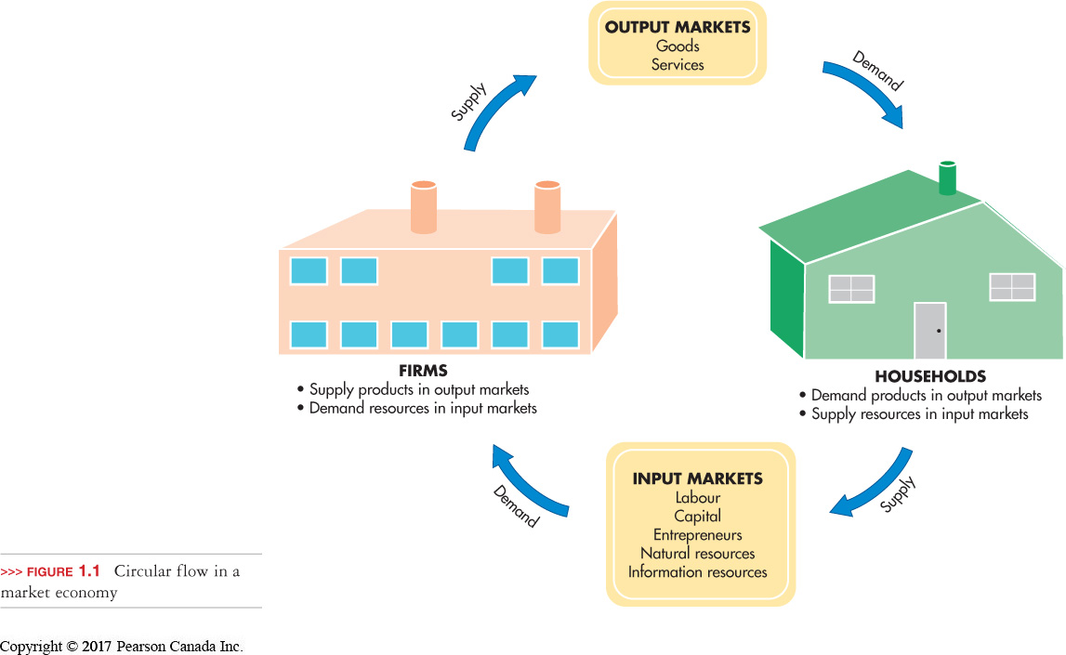
Economic Systems Around the World (LO 1-2)
Input market
firms buy resources from households
Output market
households buy goods and services from firms
Notes:
5
Learning Objective: 1-2
Page(s): 9
Figure 1.1
Activities
Have students list the types of products that apply to input and output markets.

Slide 6
Supply and Demand (LO 1-3)
Dealing with a Shortage
A shortage drives prices up
Notes:
6
Learning Objective: 1-4
Page(s): 14
Notes
Shortage: a lack of supply
Limited supply will shift the Supply Curve sideways to the left.
This will create a new equilibrium price crossing the Demand Curve at a higher price point than normal.
This shows that shortages drive prices up.
Individual suppliers will lose potential revenue from selling more units even at lower prices.
The lack of supply can anger consumers and destroy their confidence in the market and its suppliers.
Suppliers attempt to produce the number demanded to avoid shortages or surpluses which are ultimately damaging and reduce profits.

Slide 7
Supply and Demand (LO 1-3)
Dealing with a Surplus
A surplus drives prices down
Notes:
7
Learning Objective: 1-4
Page(s): 14
Notes
Surplus: an abundance of supply
Extra supply will force the Supply Curve to shift sideways to the right.
This will create a new equilibrium price crossing the Demand Curve at a price point which is lower than normal.
This shows that surpluses drive prices down.
Individual suppliers will have waste and lose profits.

Slide 8
Private Enterprise and Competition (LO 1-5)
Private enterprise occurs in a market economy with little government restriction
Under this system individuals
can own property
have freedom of choice
have the freedom to earn profits
have freedom to compete
Notes:
8
Learning Objective: 1-5
Page(s): 14-16
Activity
Class Discussion: Private property is a basic right that most of us take for granted. Give examples of how some people in non-capitalist nations do not have our right to private property. How would students respond if their rights were suddenly gone? How much of their future career prospects revolve around the freedom to acquire and control their own property? Does one’s property define who and what they are in our consumer-oriented society?

Slide 9
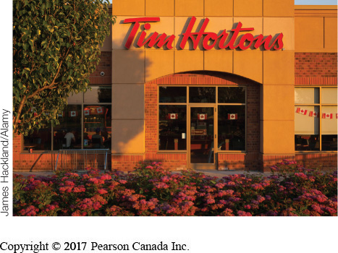
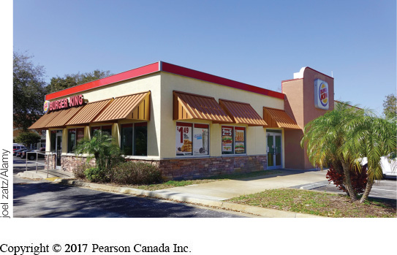
Private Enterprise and Competition (LO 1-5)
Competition
occurs when businesses vie for the same resources or customers in a particular market or industry.
motivates business to operate efficiently
forces business to make products better or cheaper
Notes:
9
Learning Objective: 1-5
Page(s): 14-16

Slide 10
Private Enterprise and Competition (LO 1-5)
Degrees of Competition
Perfect Competition
Monopolistic Competition
Oligopoly
Monopoly
Notes:
10
Learning Objective: 1-5
Page(s): 14-16
Notes
The degrees of competition are influenced by:
The number of firms competing for the same consumer’s dollar
The similarity of their products or services in the eyes of consumers
This influences the firms by:
Giving them more, or less, control over price depending on various factors
Making it more difficult to compete, or not, depending on various factors

Slide 11
Private Enterprise and Competition (LO 1-5)
Perfect Competition
many sellers; product is basically identical
relatively easy to enter the industry
individual firms have no control over price
Notes:
11
Learning Objective: 1-5
Page(s): 14-16

Slide 12
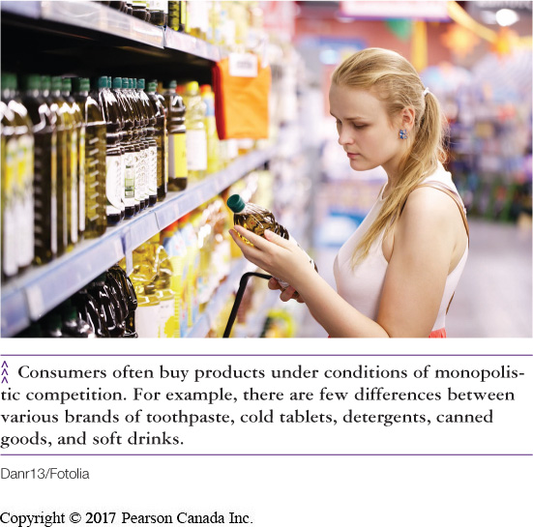
Private Enterprise and Competition (LO 1-5)
Monopolistic Competition
few to many sellers; product is seen as unique by some buyers (not all)
differentiated brands have some (minor) control over pricing
Notes:
12
Learning Objective: 1-5
Page(s): 14-16

Slide 13
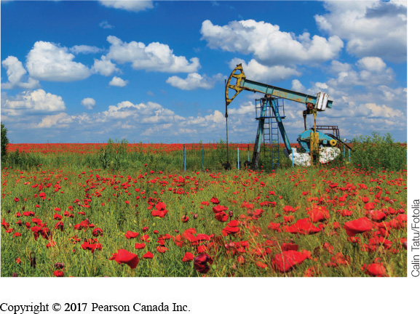
Private Enterprise and Competition (LO 1-5)
Oligopoly
a few large suppliers dominate
high barriers to entry
products are seen as similar
prices gravitate toward a common “market price”
Monopoly
one producer and source of supply
unique product
complete control over price
no competitors
Notes:
13
Learning Objective: 1-5
Page(s): 14-16
Notes
Oligopolies are confusing because some have more than a few contenders. The operational issue in these cases is that the few are large enough to dominate the market.
If one raises his/her price, they will lose sales to the others
If one lowers his/her price, the others will lower prices to compete and everyone earns less money
Examples typically include:
Automobiles
Retail gasoline dealers
Sugar producers

Slide 14
QUICK-CHECK QUESTIONS
2) When Henry Ford adopted the assembly line to mass produce the Model-T in 1913, he decided to pay his workers a relatively high wage because he believed that workers should be able to afford to buy what they make. This is consistent with the idea of _______________.
A) communism
B) input and output markets
C) socialism
D) privatization
Answer:
B) input and output markets
Notes:
14
14

Slide 15
QUICK-CHECK QUESTIONS
3) The political basis for the free market economy is called ____________ which allows private ownership of the factors of production and encourages entrepreneurship by offering profits as an incentive.
A) Marxism
B) Capitalism
C) Consumerism
D) Socialism
Answer:
B) Capitalism
Notes:
15
15

Slide 16
QUICK-CHECK QUESTIONS
4) If Justin Bieber is playing to a sold-out concert this Friday night but tickets are still in high demand, concert-goers are likely to buy tickets from ‘scalpers’ at prices considerably higher than the original price. This situation can be described as a:
A) shortage; in which quantity demanded exceeds quantity supplied.
B) surplus; in which quantity demanded exceeds quantity supplied.
C) shortage; in which quantity supplied exceeds quantity demanded.
D) surplus; in which quantity supplied exceeds quantity demanded.
Answer:
A) shortage; in which quantity demanded exceeds quantity supplied.
Notes:
16
16

Slide 17
QUICK-CHECK QUESTIONS
5) The markets for laundry detergents, soft drinks and cars are all dominated by just a few producers. In terms of competition these markets are described by the term:
A) perfect competition
B) monopoly
C) oligopoly
D) pure competition
Answer:
C) Oligopoly
Notes:
17
17

Slide 18
QUICK-CHECK QUESTIONS
1) Environmental protection laws, interest rates, societal values, and the emergence of new technologies can significantly impact the profitability of a firm. These types of issues can not be controlled by a business as they are considered to exist in the ________.
A) external environment
B) internal environment
C) organization’s boundaries
D) global context
Answer:
A) external environment
Notes:
18

Slide 19
QUICK-CHECK QUESTIONS
2) The total amount of money that a country owes its creditors.
A) National Deficit
B) Purchasing Power Parity Index
C) National Debt
D) Gross Domestic Product
Answer:
C) National Debt
Notes:
19

Slide 20
QUICK-CHECK QUESTIONS
3) The federal government manages the Canadian economic system through two sets of policies: fiscal and monetary. Fiscal Policy refers to:
A) the control of the money supply
B) the control of interest rates
C) the government’s approach to its spending and taxation
D) the effective management and control of the national debt
Answer:
C) the government’s approach to its spending and taxation
Notes:
20

Slide 21
QUICK-CHECK QUESTIONS
4) Simon would like to buy a Valentines gift for his girlfriend as a sign of his affection. To his disappointment he discovers that roses cost $75 a dozen. Luckily, he can buy chocolates for $20. According to Porter’s Five Forces Model, chocolates are a less costly _________.
A) option
B) substitute
C) replacement
D) complement
Answer:
B) substitute
Notes:
21

Slide 22
QUICK-CHECK QUESTIONS
5) An organization’s core competencies refers to:
A) The company’s strategies to increase market share
B) The company’s product offerings which achieve the highest profit levels
C) The training programs used to increase employee productivity
D) The skills and resources with which they compete best and create the most value for owners.
Answer: D) The skills and resources with which they compete best and create the most value for owners.
Notes:
22

